Slide 1
Self-driving Cars
Josh Howard

Slide 2
What are self driving cars?
Levels of automation
Level 0 – No automation
Level 1 – Driver Assistance
Level 2 - Partial Automation
Level 3 - Conditional Automation
Level 4 - High Automation
Level 5 - Full Automation

Slide 3
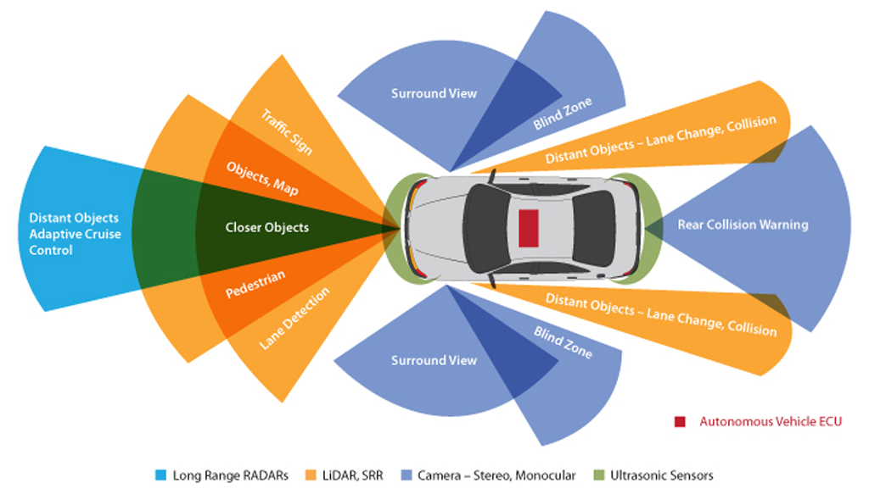
How do they work?
Radar – Calculate distance
Cameras – View the area around the car
LiDAR – Builds a map of the world around you
Sensors

Slide 4

What does this look like to a car?

Slide 5
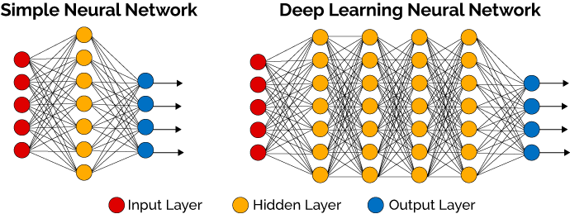
How is this achieved?

Slide 6

How is this tested and does it work?

Slide 7
References
https://www.nvidia.com/en-us/self-driving-cars/drive-platform/
https://www.nvidia.com/en-us/self-driving-cars/
https://www.techradar.com/news/driverless-cars-explained
https://www.youtube.com/watch?v=0rc4RqYLtEU
https://www.caranddriver.com/features/a15079828/autonomous-self-driving-car-levels-car-levels/
https://www.youtube.com/watch?v=0rc4RqYLtEU
https://www.nvidia.com/en-us/self-driving-cars/drive-platform/
https://www.wired.com/story/the-know-it-alls-how-do-self-driving-cars-see/
https://towardsdatascience.com/mnist-vs-mnist-how-i-was-able-to-speed-up-my-deep-learning-11c0787e6935
https://blogs.nvidia.com/blog/2015/02/19/deep-learning-2/
https://www.youtube.com/watch?v=booEg6iGNyo

